Slide 1

Predicting Vehicle Carbon Dioxide Emissions Using Machine Learning
Presented by S Nandana
Notes:
NOTE:
To change the image on this slide, select the picture and delete it. Then click the Pictures icon in the placeholder to insert your own image.

Slide 2
Content
Project Description
Objective
Description of Data
Exploratory Data Analysis
Model Selection
Model Evaluation
Model Deployment
Conclusion

Slide 3
Project Description
CO2 emissions from vehicles are a significant contributor to global warming and climate change. The widespread use of internal combustion engine (ICE) vehicles powered by gasoline and diesel fuels has led to substantial CO2 emissions, affecting air quality and public health. Various factors, including driving habits, fuel type, and vehicle efficiency, influence the emission of high amounts of CO2. Understanding these factors is crucial to developing effective strategies to mitigate the impact of vehicle emissions on the environment and climate.
Objective
The objective of this project is to analyze the factors influencing high CO2 emissions from vehicles, develop predictive models to assess and identify vehicles emitting high amounts of CO2 and propose strategies for mitigating these emissions. This aims to contribute towards addressing global warming and climate change by promoting more sustainable transportation practices.

Slide 4
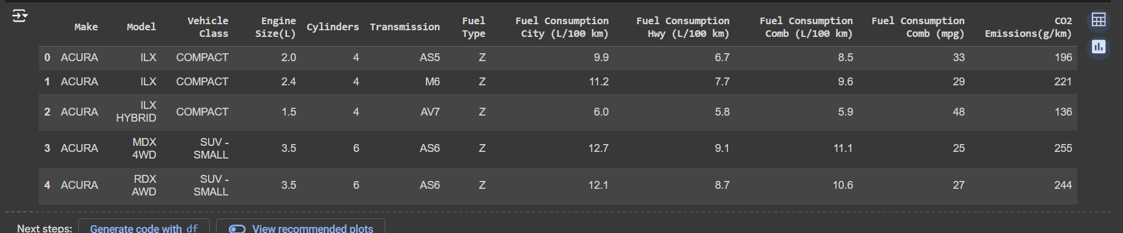
Description of data
This dataset captures the details of how CO2 emissions by a vehicle can vary with the different features. The dataset has been taken from the Canada Government’s official open data website. This is a compiled version. This contains data over a period of 7 years. It’s a regression dataset.
There are a total of 7385 rows and 12 columns.

Slide 5
There are a few abbreviations that have been used to describe the features.
Model
4WD/4X4 = Four-wheel drive
AWD = All-wheel drive
FFV = Flexible-fuel vehicle
SWB = Short wheelbase
LWB = Long wheelbase
EWB = Extended wheelbase
Transmission
A = Automatic
AM = Automated manual
AS = Automatic with select shift
AV = Continuously variable
M = Manual
3 - 10 = Number of gears
Fuel type
X = Regular gasoline
Z = Premium gasoline
D = Diesel
E = Ethanol (E85)
N = Natural gas
Fuel Consumption
City and highway fuel consumption ratings are shown in liters per 100 kilometers (L/100 km) - the combined rating (55% city, 45% highway) is shown in L/100 km and in miles per gallon (mpg)
CO2 Emissions
The tailpipe emissions of carbon dioxide (in grams per kilometer) for combined city and highway driving

Slide 6
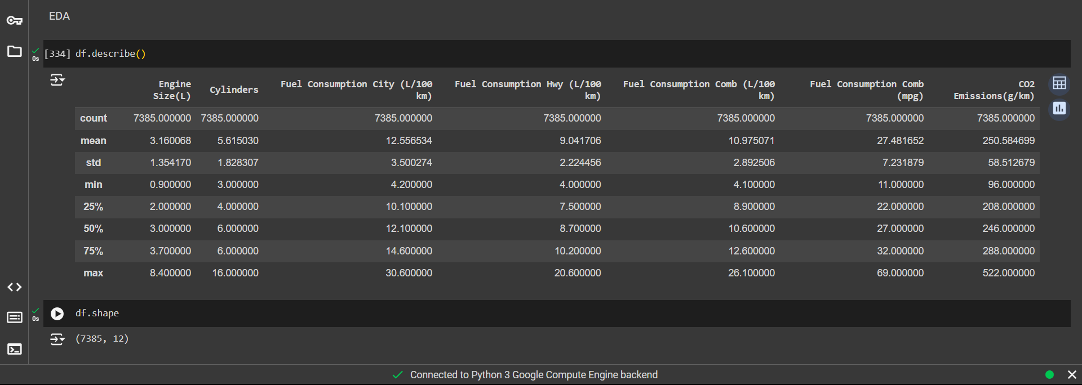
Exploratory data analysis

Slide 7
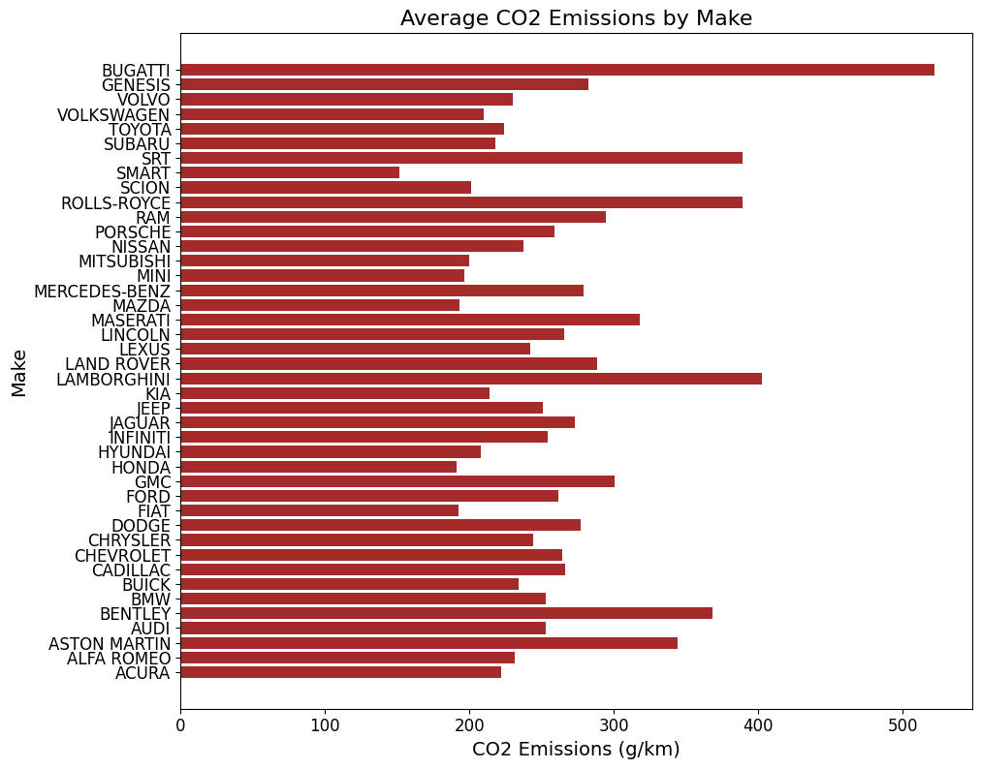
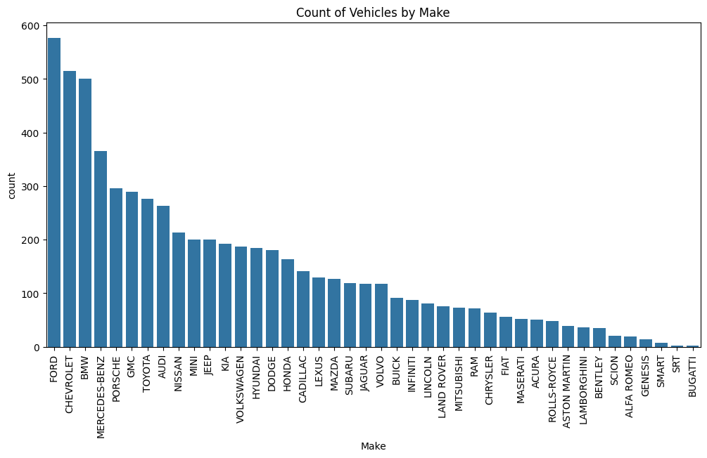
There were no missing values in the dataset. The presence of Duplicate rows was checked and removed accordingly.
Univariate analysis, bivariate analysis, and multivariate analysis of various features were analysed to understand the patterns and distribution and their relationship with the target variable.

Slide 8
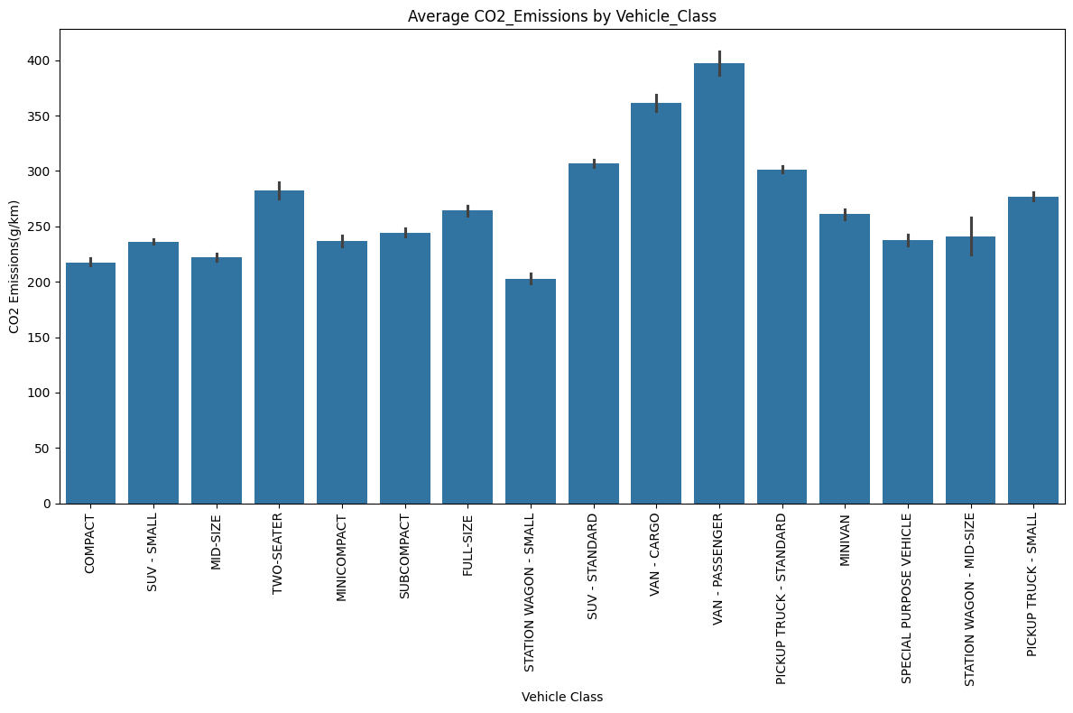
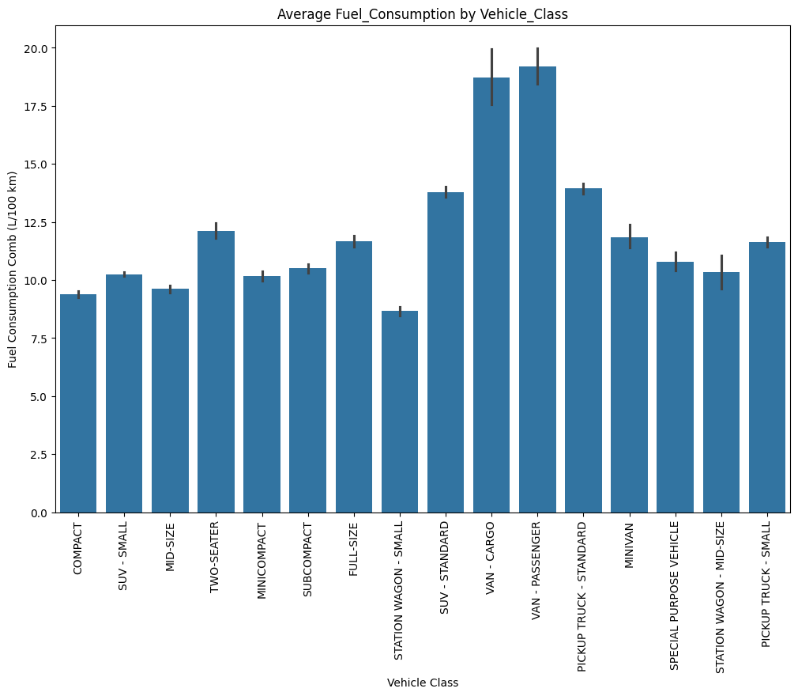
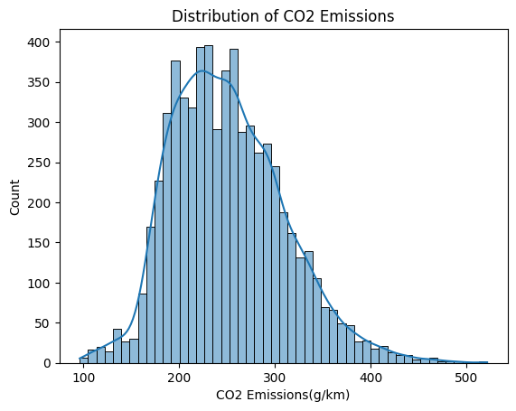

Slide 9
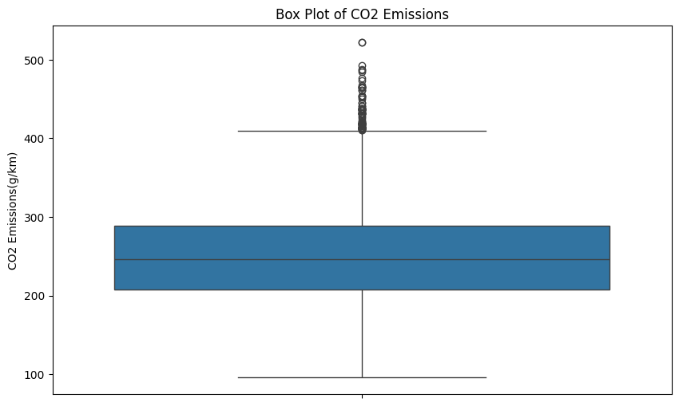
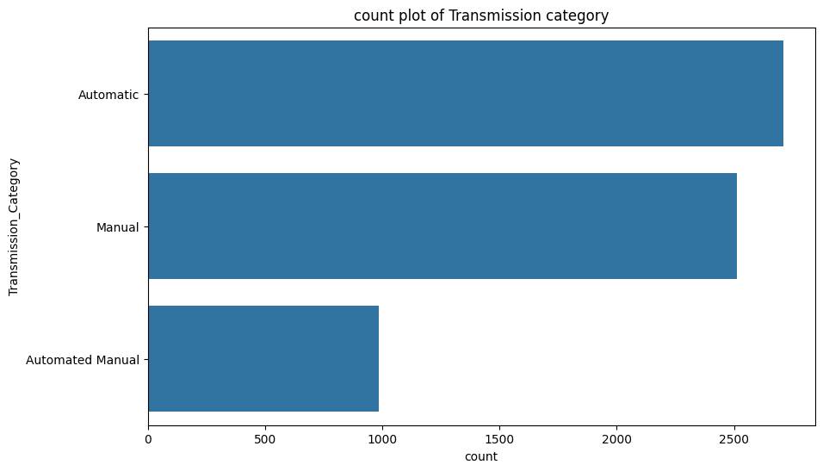
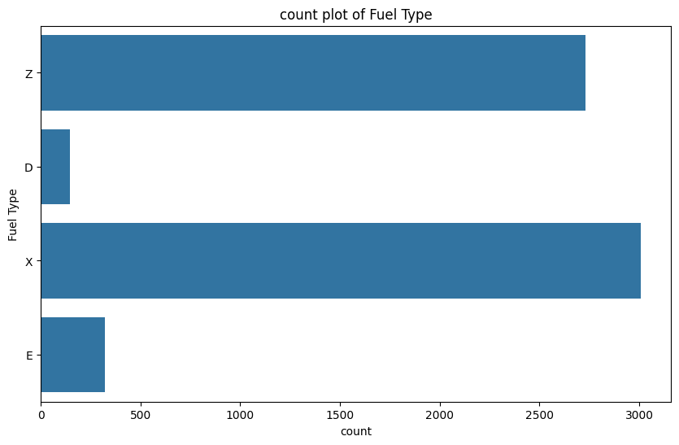
Detection of outliers
Using a boxplot one can spot the outliers in a dataset. In the above diagram. Outliers are spotted beyond the whisker. Those outliers were removed using the interquartile range.

Slide 10
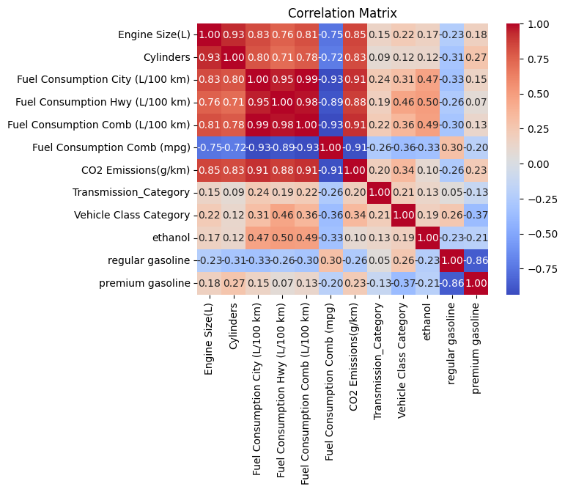
Almost all the variables have a positive relationship with that of the target variable
Some varibales are correlated and might have multicollinearity
Darker shades indicate a high correlation among variables

Slide 11
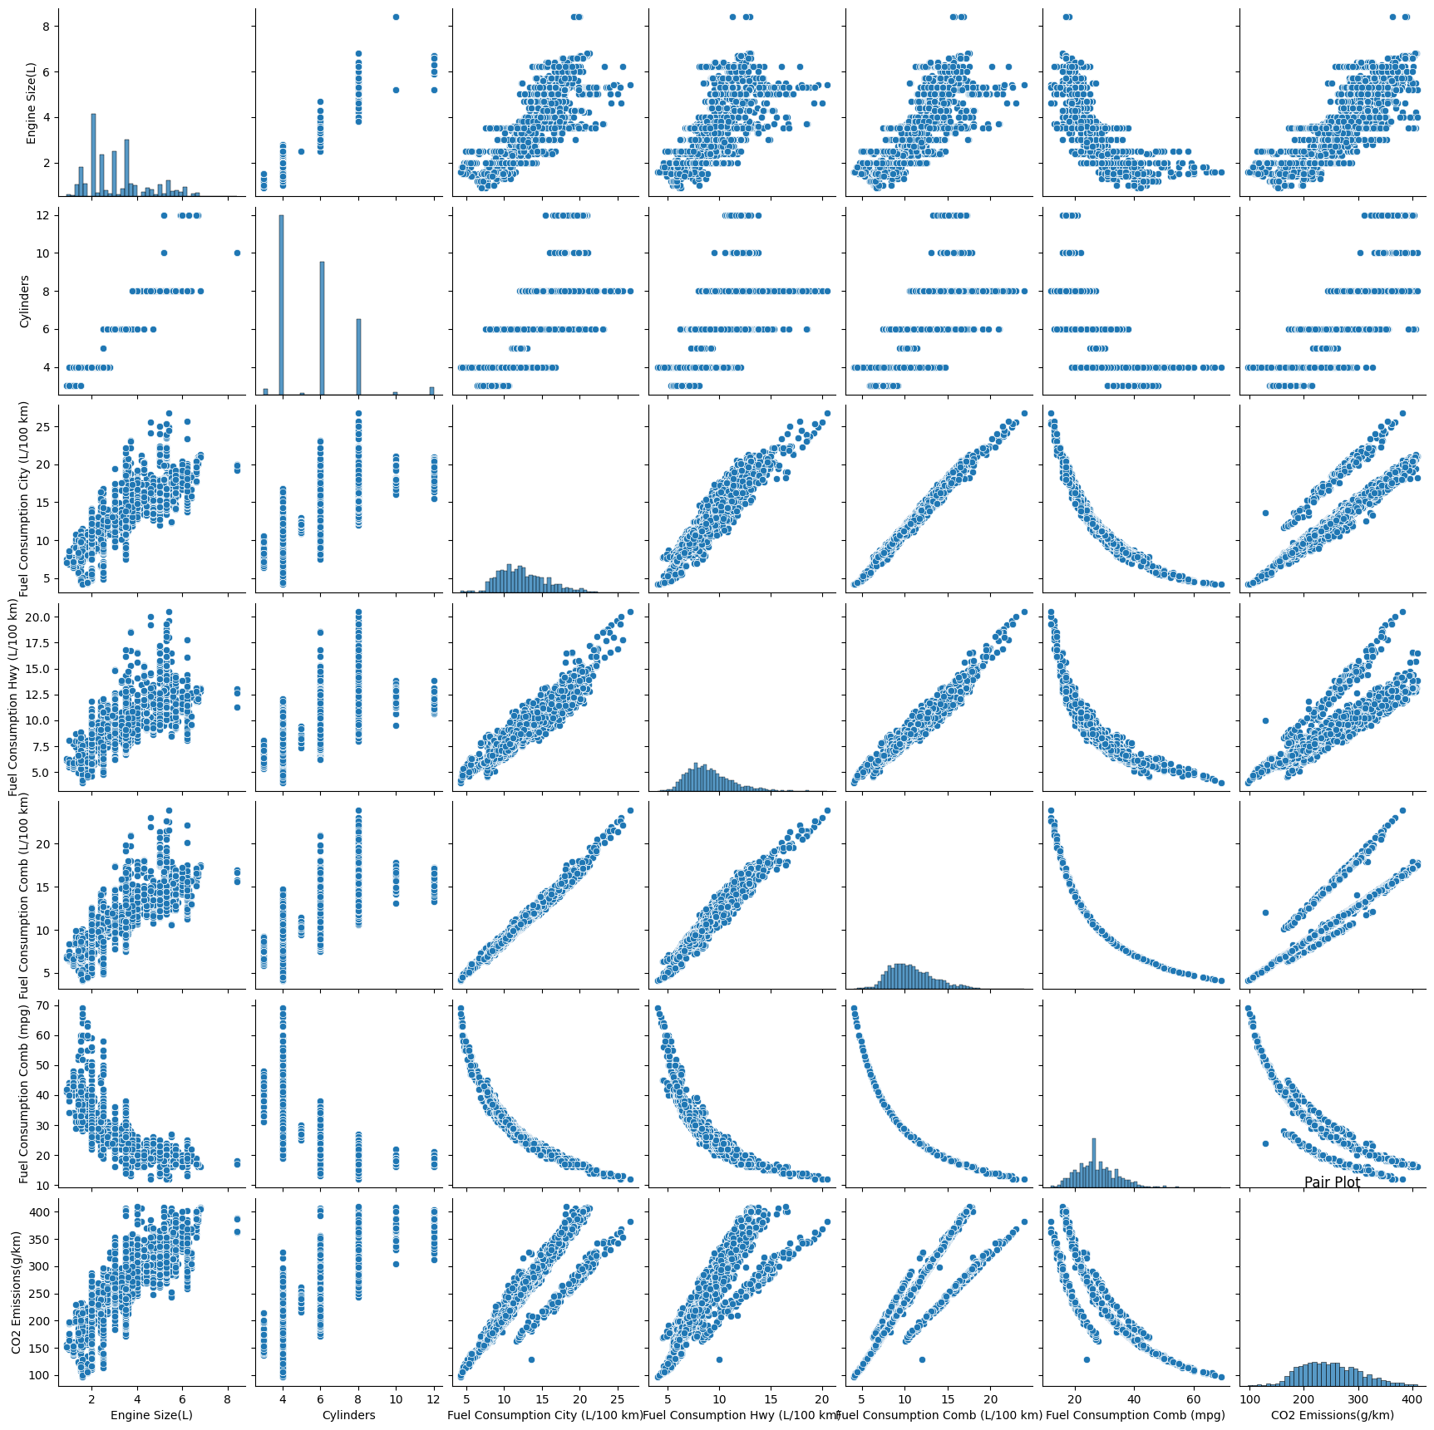
Pairplot
Paiplot helps in understanding the pairwise relationships between different variables in a dataset.
All the variables have a linear relationship with target variable
The histograms along the diagonal show the distribution of each variable. For example, the engine size distribution is right-skewed, indicating that most vehicles have smaller engine sizes. The distribution of CO2 emissions is also right-skewed.
The plots show a clear linear relationship, highlighting that more fuel consumption leads directly to higher emissions.

Slide 12
Categorization of variables
Transmission Categories
Vehicle Class Categories
To streamline the analysis and modeling process, we categorized the 'Transmission' variable into three broader categories: 'Automated Manual', 'Automatic', and 'Manual'. The rationale behind this categorization is to reduce the complexity arising from the numerous specific transmission types, each of which may not have sufficient representation in the dataset for reliable modeling.
Automated Manual: Includes all variants of automated manual transmissions (e.g., AV7, AV6, AM5).
Automatic: Encompasses all standard automatic transmissions (e.g., AS6, AS8).
Manual: Groups all manual transmission types (e.g., M6, M7).
This categorization helps in simplifying the model and potentially improving its performance by focusing on the broader behavior of transmission types rather than their specific subtypes.
Similarly, the 'Vehicle Class' variable was categorized into four main groups: 'SUVs', 'Cars', 'Trucks', and 'Others'. This grouping was done based on the typical use cases and characteristics of the vehicles:
SUVs: Includes both small and standard SUVs.
Cars: Covers various car types including mid-size, compact, subcompact, and full-size vehicles.
Trucks: Consists of standard and small pickup trucks.
Others: Encompasses other types of vehicles such as vans and special purpose vehicles.
This categorization aligns with common industry practices and helps in reducing the model complexity, allowing for more robust and interpretable results.

Slide 13
Most of the vehicles are automatic and manual
Most of the cars vehicles use Regualar gasoline or premium gasoline as fuel.

Slide 14
Converting categorical variables to numeric
Using label encoder converted transmission category and vehicle category to numeric,
Using one hot encoder converted fuel type to numeric.
Splitting the data into training and testing
Split the dataset into a 70:30 ratio of training and testing dataset.
Using minmax scaler, scaled the trained and tested dataset.

Slide 15
Regression Models
To find the best model to predict the amount of carbon dioxide emitted, the following were used:
Linear regression (Multiple Linear Regression)
Lasso Regression
Support Vector Regression
Decision Tree Regressor
Random Forest Regressor
Extreme Gradient Boosting

Slide 16
Linear Regression (Multiple Linear Regression):
Linear regression is a fundamental statistical method used to model the relationship between a dependent variable and one or more independent variables. Multiple linear regression extends this to include multiple independent variables. The goal is to find the best-fitting linear equation that minimizes the sum of squared residuals .
Lasso Regression:
Lasso (Least Absolute Shrinkage and Selection Operator) regression is a type of linear regression that includes a penalty equal to the absolute value of the magnitude of coefficients. This helps in feature selection by shrinking some coefficients to zero, thus removing them from the model.
Support Vector Regression (SVR):
SVR is a type of support vector machine (SVM) for regression tasks. It attempts to find a hyperplane in a high-dimensional space that best fits the data. SVR uses kernel functions to transform the data and make it possible to perform the linear separation in a higher-dimensional space.
Decision Tree Regressor:
A decision tree regressor splits the data into subsets based on the value of input features, forming a tree structure. Each leaf node of the tree represents a predicted value. The model works by recursively splitting the data at points that result in the maximum reduction in variance.

Slide 17
Random Forest Regressor:
A random forest regressor is an ensemble method that constructs multiple decision trees during training and outputs the average prediction of individual trees. It improves prediction accuracy and controls overfitting by averaging multiple trees, which decorrelates individual trees.
Extreme Gradient Boosting (XGBoost):
XGBoost is an advanced implementation of gradient boosting for supervised learning. It builds trees sequentially, with each new tree correcting errors made by previous ones. XGBoost optimizes both the model's performance and computational speed using parallel processing and other enhancements.

Slide 18
Model Evaluation
Model metrics used to evaluate regression models were
Mean Square error
Mean Absolute Error
Root Mean Square Error
R2_Score
After evaluation of all the models XGB had minimum MSE,MAE,RMSE, and highest R2_score compared to other models.
Mean Absolute Error: 2.1043865676855313
Mean Squared Error: 11.106306404307675
Root Mean Square Error: 4.972055089801721
R2_squared: 0.9964647563550962

Slide 19
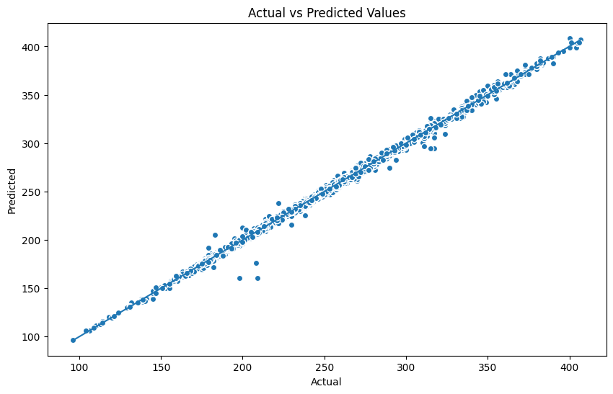

Slide 20
Model Deployment and User Interface
To efficiently predict CO2 emissions, we implemented the following: Saved the trained model as a pickle file for future use. Enhances efficiency and easy deployment.
Developed an interactive app using Streamlit for real-time predictions. Users input features and the app displays predicted CO2 emissions.

Slide 21
Conclusion
In this project, we successfully developed a machine-learning model to predict CO2 emissions based on vehicle features. By saving the trained model as a pickle file and creating an interactive web interface using Streamlit, we provided a practical tool for real-time CO2 emission predictions. This solution enhances accessibility and usability, making it valuable for stakeholders aiming to reduce their carbon footprint. Accurate CO2 emission predictions are crucial for understanding and mitigating environmental impacts. This project demonstrates how machine learning can be leveraged to provide actionable insights, helping individuals and organizations make informed decisions to reduce CO2 emissions and contribute to a more sustainable future.

